Slide 1
EMTH403
Mathematical Foundation for Computer Science

Slide 2
Lecture Outcomes
understand some more applications of Eulers theorem for planar graphs.
understand 3 corollary for planar graphs.

Slide 3
Euler’s Formula (Cont.)
Corollary 1: If G is a connected planar simple graph with e edges and v vertices where v ≥ 3, then e ≤ 3v - 6.
Is K₅ planar?
Yes No
Answer: No
K₅

Slide 4
Euler’s Formula (Cont.)
K₅ has 5 vertices and 10 edges.
We see that v ≥ 3.
So, if K₅ is planar, it must be true that e ≤ 3v – 6.
3v – 6 = 3*5 – 6 = 15 – 6 = 9.
So e must be ≤ 9.
But e = 10.
10 is not ≤ 9.
So, K₅ is nonplanar.
K₅

Slide 5
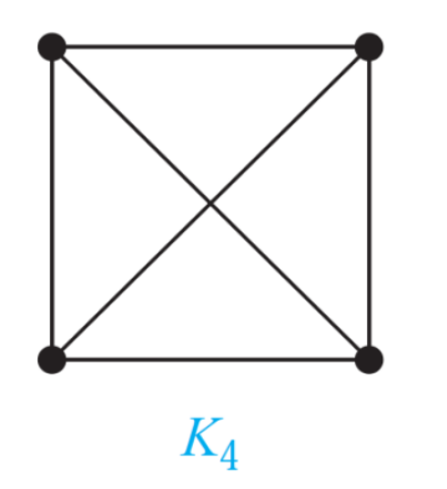
Euler’s Formula (Cont.)
Corollary 1: If G is a connected planar simple graph with e edges and v vertices where v ≥ 3, then e ≤ 3v - 6.
Is K₄ planar?
Yes No
Answer: Yes

Slide 6
Euler’s Formula (Cont.)
K₄ has 4 vertices and 6 edges.
We see that v ≥ 3.
So, if K₄ is planar, it must be true that e ≤ 3v – 6.
3v – 6 = 3*4 – 6 = 12 – 6 = 6.
So e must be ≤ 6.
But e = 6.
6 is ≤ 6.
So, K₄ is planar.

Slide 7
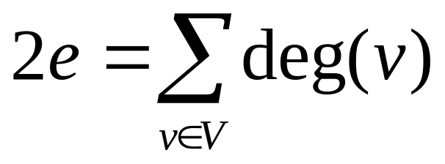
Euler’s Formula (Cont.)
Corollary 2: If G is a connected planar simple graph, then G must have a vertex of degree not exceeding 5.
If G has one or two vertices, it is true;
thus, we assume that G has at least three vertices.
If the degree of each vertex were at least 6, then by Handshaking Theorem, 2e ≥ 6v, i.e., e ≥ 3v,
but this contradicts the inequality from Corollary 1: 1 e ≤ 3v – 6.

Slide 8
Euler’s Formula (Cont.)
Corollary 3: If a connected planar simple graph has e edges and v vertices with v ≥ 3 and no circuits of length 3, then e ≤ 2v - 4.
Is K_{3,3} planar?
Yes No
Answer: No

Slide 9
Theorem 1 (Kuratowski, 1930)
A graph is planar if and only if it does not contain a subgraph that is a K₅ or K_{3,3} configuration.

Slide 10
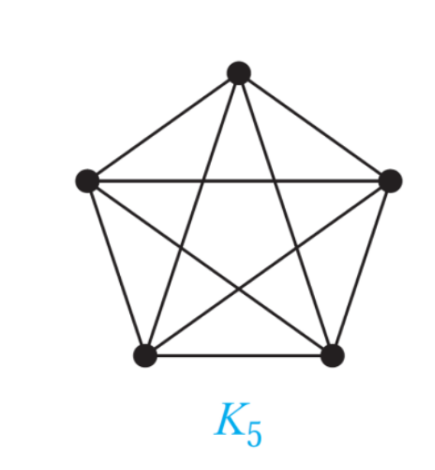
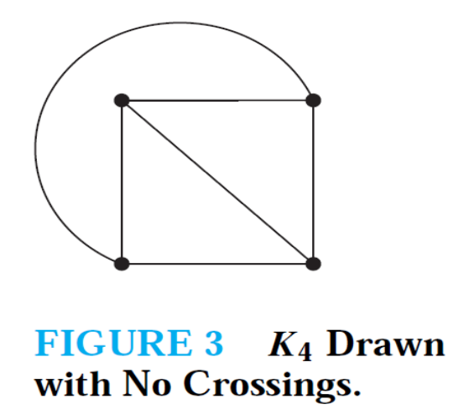
Euler’s Formula (Cont.)
Which of these nonplanar graphs have the property that the removal of any vertex and all edges incident with that vertex produces a planar graph? a) K₅
If we remove a vertex from K₅ , then we get K₄ , which is clearly planar.

Slide 11
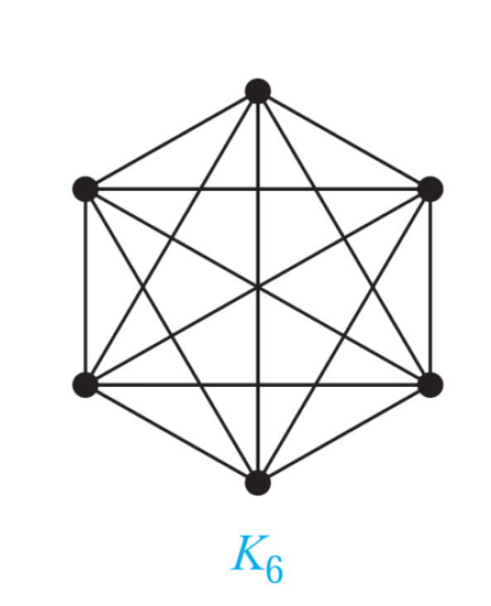
Euler’s Formula (Cont.)
Which of these nonplanar graphs have the property that the removal of any vertex and all edges incident with that vertex produces a planar graph?
b) K₆
If we remove a vertex from K₆ , then we get K₅ , which is not planar.(As shown in previous slide no. 49)

Slide 12
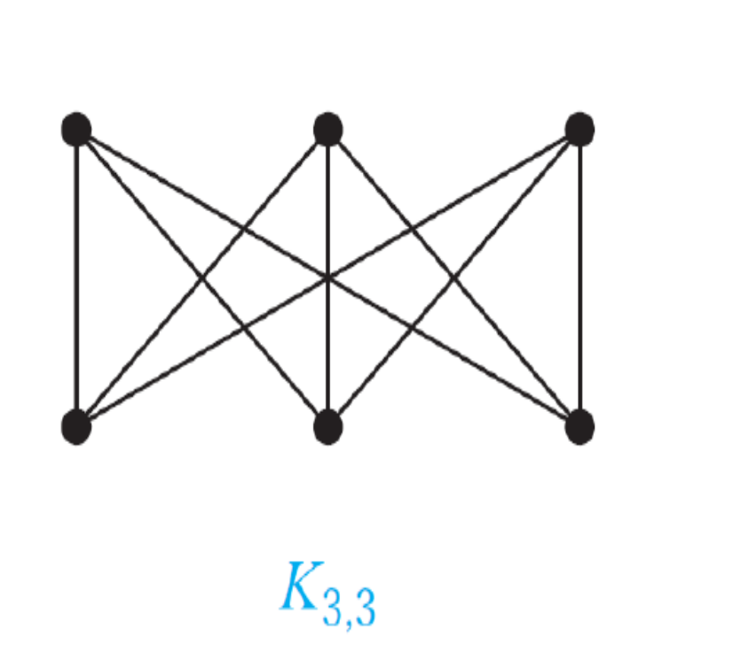
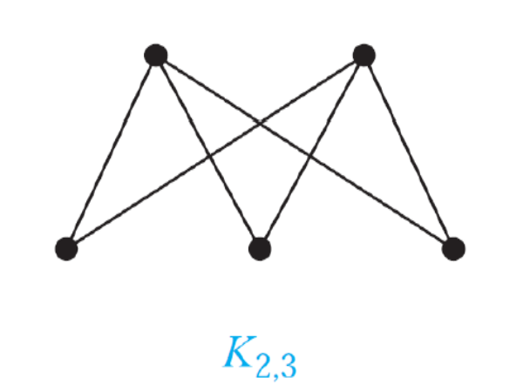
Euler’s Formula (Cont.)
Which of these nonplanar graphs have the property that the removal of any vertex and all edges incident with that vertex produces a planar graph?
c) K_{3,3}
If we remove a vertex from K_{3,3}, then we get K_{3 ,2} , which is clearly planar.

Slide 13
Euler’s Formula (Cont.)
Which of these nonplanar graphs have the property that the removal of any vertex and all edges incident with that vertex produces a planar graph?
d) K_{3,4}
The answer is no, since we can remove a vertex in the part of size 4 to leave K_{3,3} , which is not planar. (As discussed earlier in slide 30)

